Slide 1
Roadmapp
Team: Sharony Braam & Daan Brocatus

Slide 2

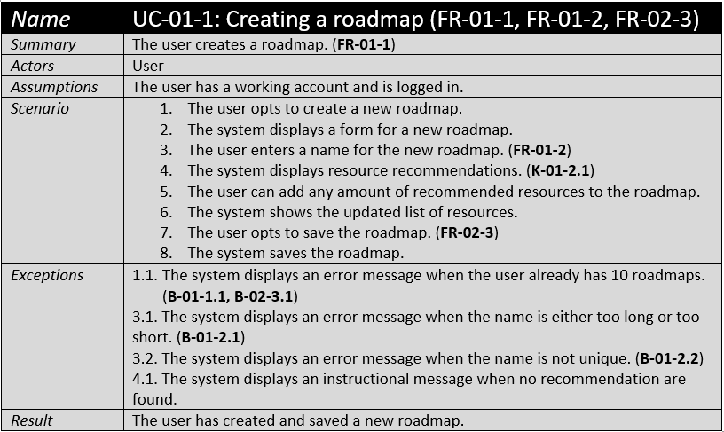
Feedback
User Stories
Use Cases
Technical Design

Slide 3
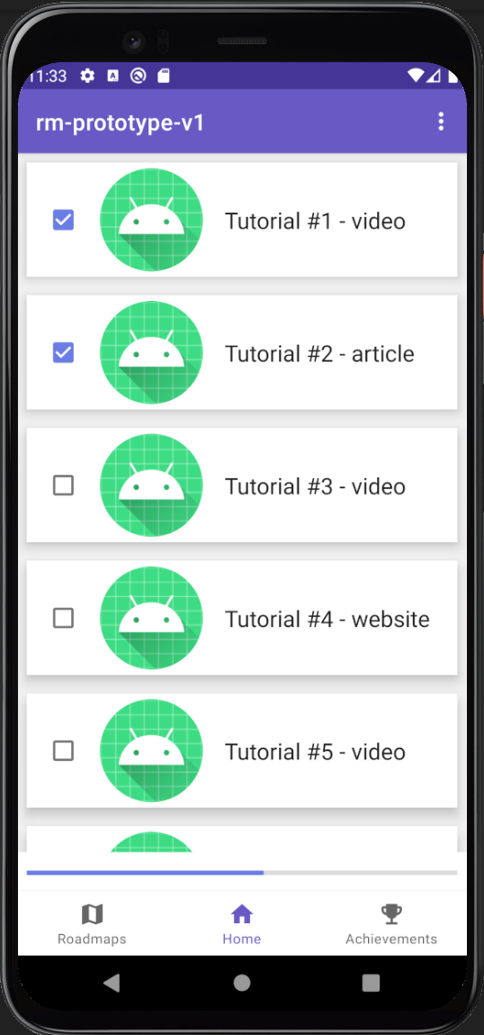
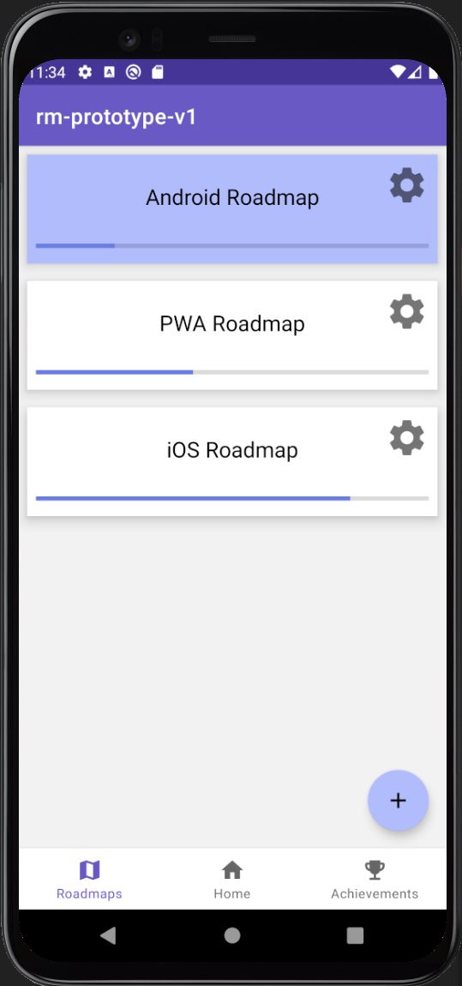
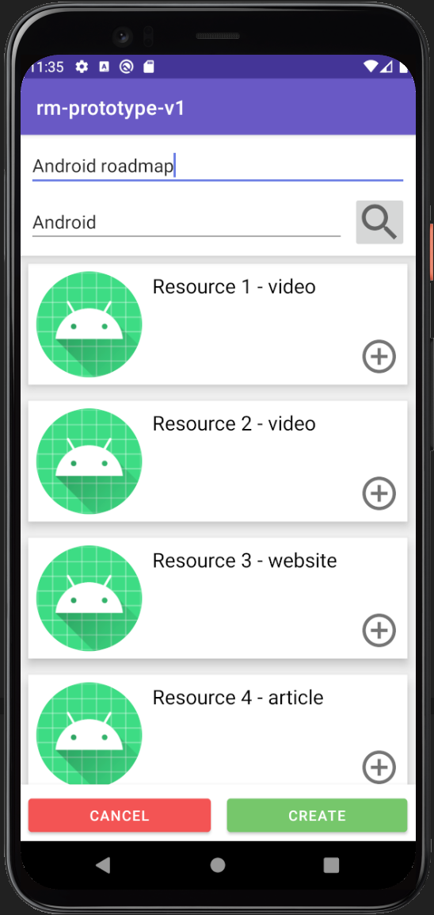
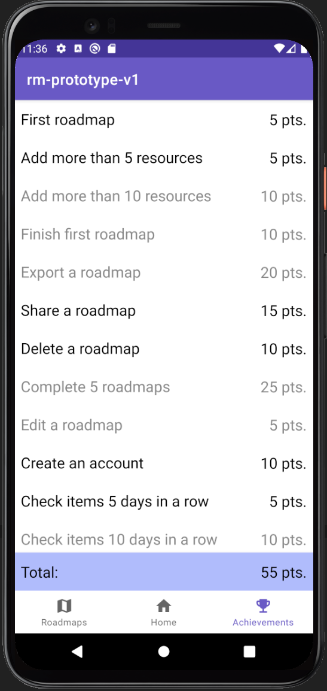
High Fidelity Prototype

Slide 4
Demo

